Slide 1

Clutch Sports
Reported By
Project Group 8
Ankit Singh (A20111177)
Akshay Arora (A20101619)
Chirag Bilimoria (A20099258)
Shreyas Siva Kumar (A20115198)
Souparna Lodh (A20101631)

Slide 2
Clutch Sports
We are a Talent Acquisition Company helping Managers of NBA teams make great tactical and scouting decisions based on the NBA stats and providing tactical decisions in order to improve player as well as a team.
Our services include player management, offensive tactics, defensive tactics, marketing research, scouting reports and upbringing the new talents in the league.
Out Motto “One Spirit, One Team, One Win”
Notes:
Our report is large because all the analysis we ran are important in order to determine the strengths of a player as well as the team. Our analysis doesn’t limit here as there could be various other analysis and stats that may affect your team and personality. As a Sport Recruitment firm it is our responsibility to carry out as many tests required in order to help our clients get the maximum output and the best talent present on the table.

Slide 3
Data Definitions
Player Efficiency Rating (PER) : It is a rating of a player's per-minute productivity. It's per-minute and is pace-adjusted.
Usage Percentage (USG%) : It is an estimate of the percentage of team plays used by a player while present on the floor.
Value Over Replacement Player (VORP) : A box score estimate of the points per 100 TEAM possessions that a player contributed above a replacement-level player.
Field Goal Made (FGM) and Field Goal Attempted (FGA) are the number of shots made and attempted by a player.
3 pointer made (3PM) and 3 pointer attempted (3PA) are the 3 pointer shots made and attempted by a player.
Free Throw made (FTM) and Free Throw attempted (FTA) are the free throw shots made and attempted by a player.

Slide 4
Data Definitions
Field Goal percentage (FG%), 3 Pointer percentage (3P%) and Free Throw percentage (FT%) are the percentage of the shoots a player banks in.
Offensive Win Shares (OWS), Defensive Win Shares (DWS) and Win Shares (WS) is an estimate of the number of wins contributed by a player.
TRB is the total number of rebounds fetched by a player.
AST is the number of assists dished out by a player.
STL is the steals made by a player and BLK is the blocks made by a player.
PTS is the points made by a player and TOV is the number of turnovers contributed by a player.

Slide 5
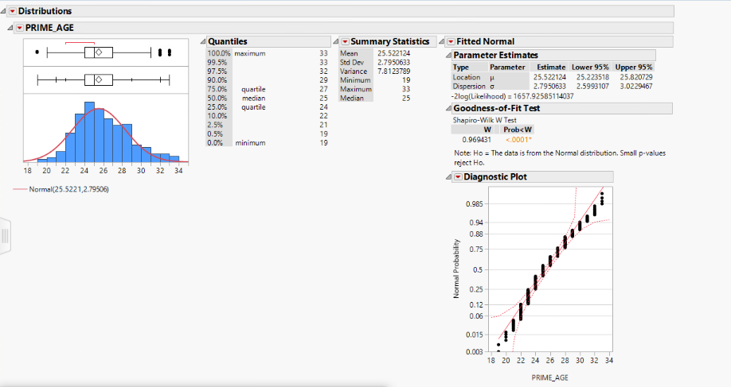
What is the prime age of a NBA player?
For this question, we did descriptive analysis on player stats from 1980 to 2017 with points, assists, rebounds, turnovers, steals and blocks on focus.
Between the age of 25 and 28 is the average age of a NBA player in his most productive season.
Only 15% had their most productive season after the age of 30. Hakeem, Bird and Gasol included.

Slide 6
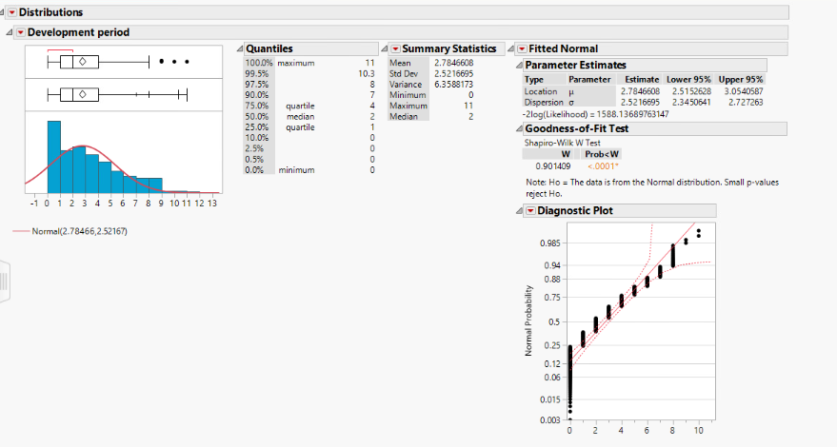
What is the development period of a young player?
For this questions, we just perform the descriptive analysis on the difference of age of prime age and the age they entered the league.
Between 4 and 5 years is the average number of years a player reaches his most productive season after he enters the NBA.
Only 20% had their most productive season within 3 years of entering the league, 7% within 2 year.

Slide 7
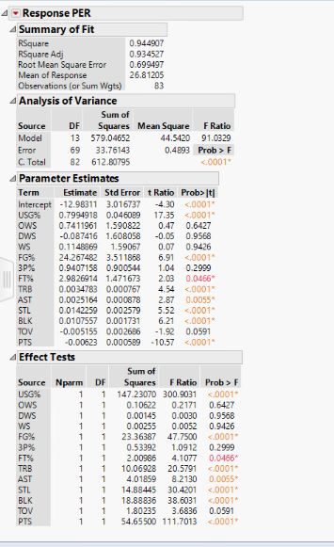
Does the MVP of the year always have the best PER?
We performed hypothesis testing for this.
Null Hypothesis Ho = The MVP of the year always has the best PER.
Alternate Hypothesis Ha = The MVP of the year always doesn’t has the best PER.
Most of the predictor are significant as it has the p-value more than 0.05.
The overall model is significant as it has p-value less than 0.05 and also the Rsquare Adj is very high indicating a good model.
Thus we reject the null hypothesis and conclude that the MVP of the year always doesn’t has the best PER.

Slide 8
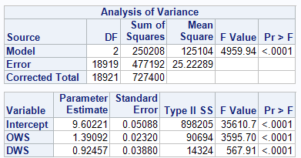
Does PER of a player depends on his Win Shares i.e. How much he contributes in winning possessions?
For this analysis, we performed a linear regression with PER as dependent variable and Win Shares as independent variables.
The overall model is significant with R-square value of 0.34 and also the Win Shares are significant.
Thus we can say from the model, the PER does depend on Win Share with positive change.
That is, a unit increase in offensive win shares increases the PER by 1.39 units and a unit increase in defensive win shares increases PER by 0.925 units.
Thus we can conclude that win shares contribute to a better PER than defensive win shares.

Slide 9
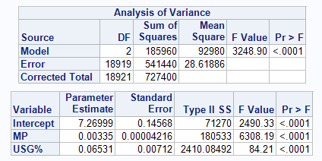
Does PER of a player depends on the usage percentage and minutes he played i.e. How many possession he uses on the court?
Again for this analysis, we performed linear regression with PER as dependent variable and minutes played and usage percentage as independent.
The overall model is significant with R-square value of 0.25 and also minutes played and usage percentage are significant.
Thus we can say from the model, the PER does depend on these parameters but not to a great extend.
So we can state that the usage percentage of a player on a court will not help boost his PER so a NBA superstar should always make sure everyone on the team participates on every single possession.

Slide 10
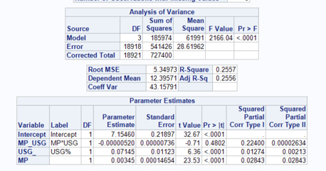
Is there an interaction between minutes played and usage percentage?
If two variables of interest interact, the relationship between each of the interacting variables and a third "dependent variable" depends on the value of the other interacting variable. In practice, this makes it more difficult to predict the consequences of changing the value of a variable, particularly if the variables it interacts with are hard to measure or difficult to control.
Looking at our regression model, we can clearly that the interaction variable i.e. MP_USG is insignificant.
Thus there is no interaction between minutes played and usage percentage and we can continue interpreting the variables as main effects and ignore the interaction.

Slide 11
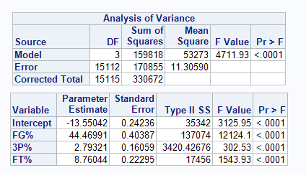
Does PER favours a good shooter in NBA?
Again for this analysis, we performed linear regression with PER as dependent variable and field goal, free throw and 3 point percentage as independent variable.
The overall model is significant with R-square value of 0.4833 and also the independent variables are significant.
Thus we can say from the model, the PER does favor a good shooter to a solid extend.
This can be further justified by analyzing the beta coefficients.
A unit increase in FG% will increase the PER by 44.47 units while a unit increase in 3 point percentage will increase the PER by almost 9 units.
Thus adding shooting skills in your arsenal will favor you both individually as well as benefit the team in clutch situation.

Slide 12
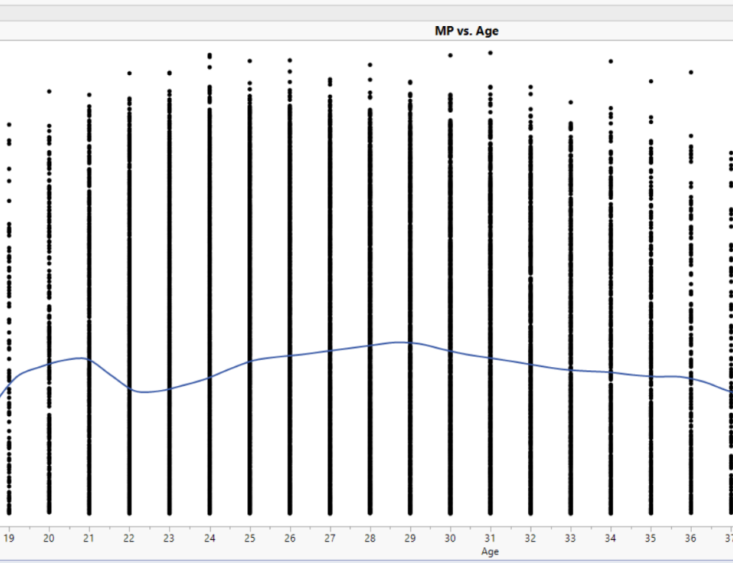
Does the player play more minutes in his prime years rather than other years?
The graph represents a plot of Minutes played versus Age.
we can see that the prime age does not determine the minutes played as there are players who have played considerably more minutes but are not at their prime age.
This can be justified from the fact that Lebron James plays more minutes at age of 33 because of mediocre team.
While Kevin Durant on his prime plays less minutes because he got wing players to help him out.

Slide 13
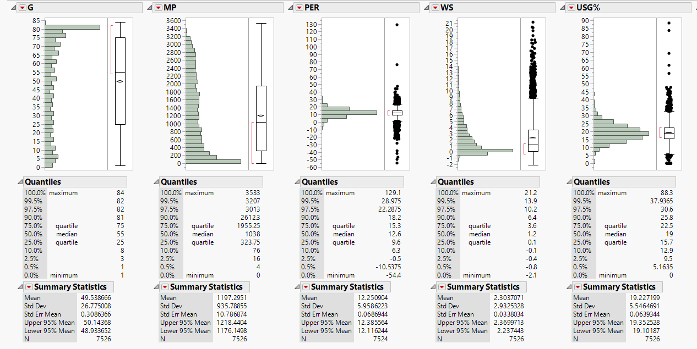
Who is the most average Guard of the league?

Slide 14
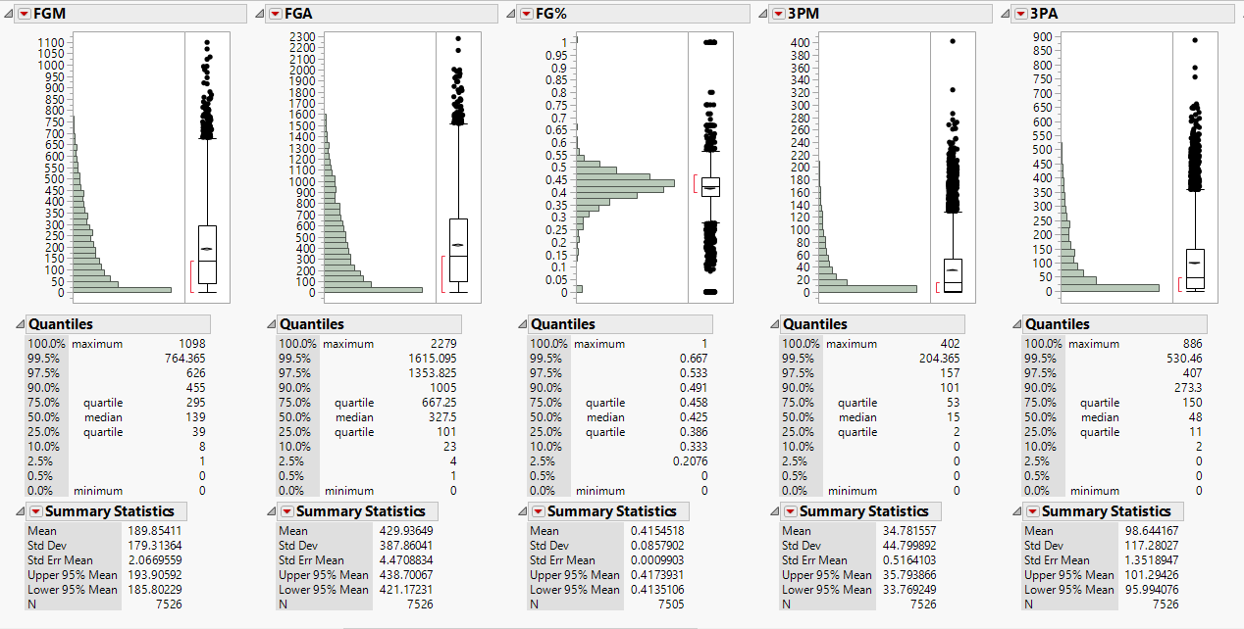
Who is the most average Guard of the league?

Slide 15
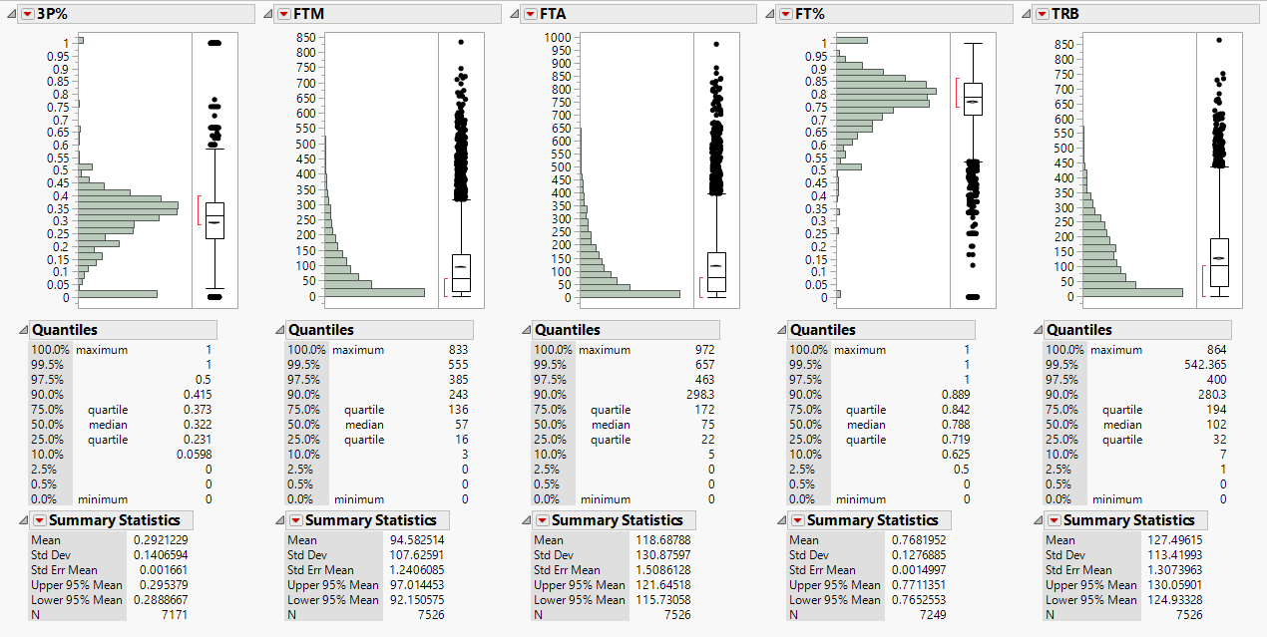
Who is the most average Guard of the league?

Slide 16
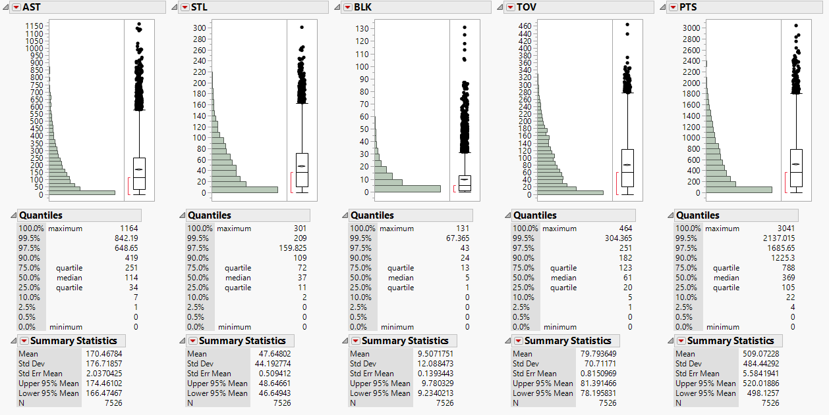
Who is the most average Guard of the league?

Slide 17
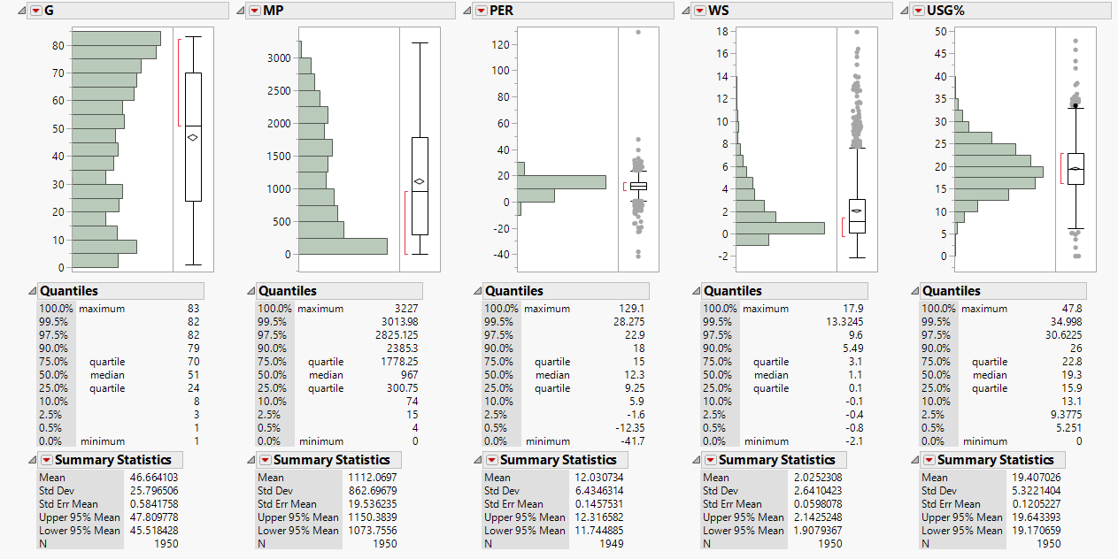
Who is the most average Guard of the league in last 17 years?

Slide 18
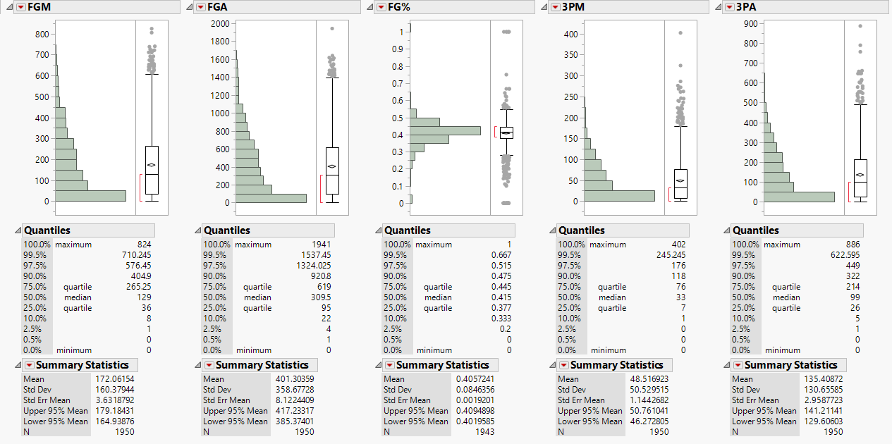
Who is the most average Guard of the league in last 17 years?

Slide 19
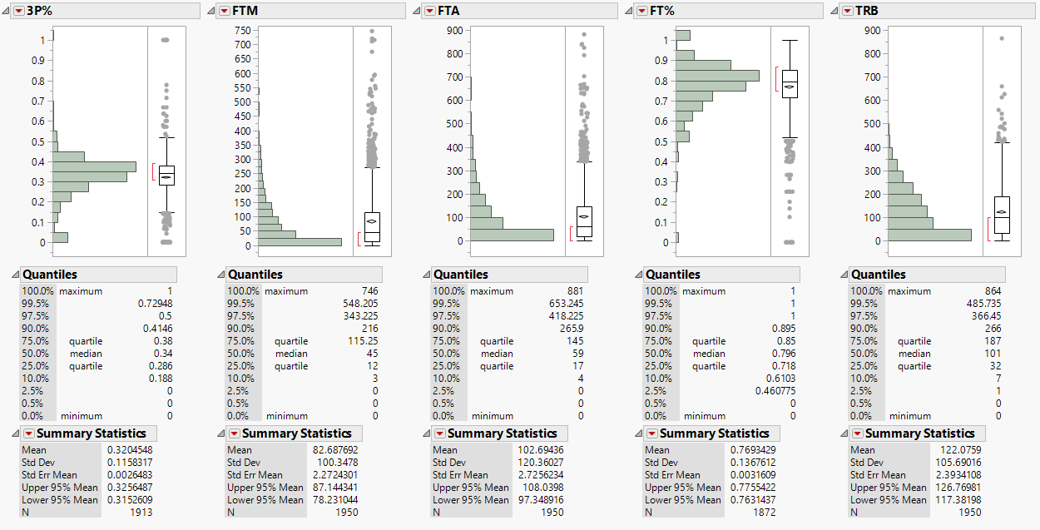
Who is the most average Guard of the league in last 17 years?

Slide 20
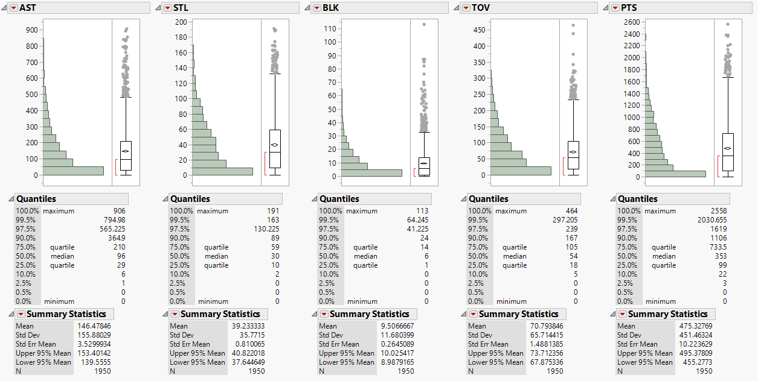
Who is the most average Guard of the league in last 17 years?

Slide 21
Analysis on Guards.
The number of games and the minutes played by the guards has decreased in last 17 years to keep them fresh for playoff runs.
But PER, WS, USG%, FG%, FT%, Blocks and Rebounds haven’t seen a significant change.
The number of field goals made, attempted, Free throw made and attempted have decreased but has no effect on efficiency.
Also, the modern NBA Guard is treat from beyond the arc with increased 3 point made, attempted and percentage.
Assists may have decreased with time but so has the turnovers and thus suggesting the guards are focal point in offense.

Slide 22
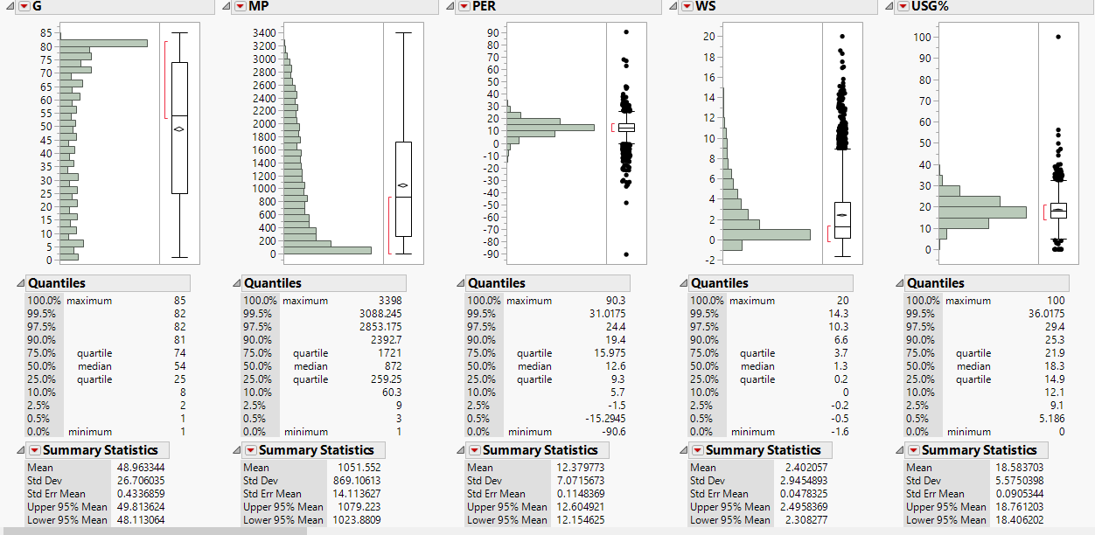
Who is the most average Centre of the league?

Slide 23
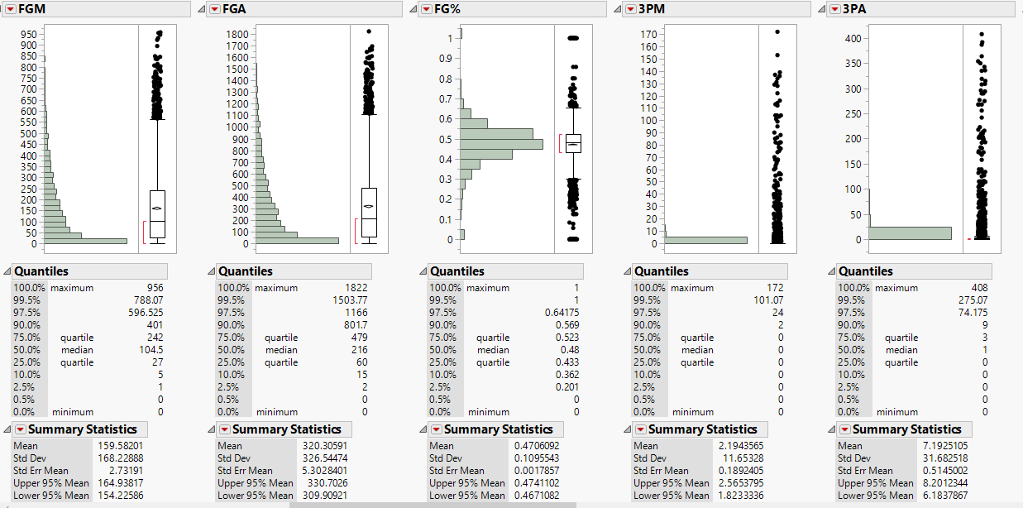
Who is the most average Centre of the league?

Slide 24
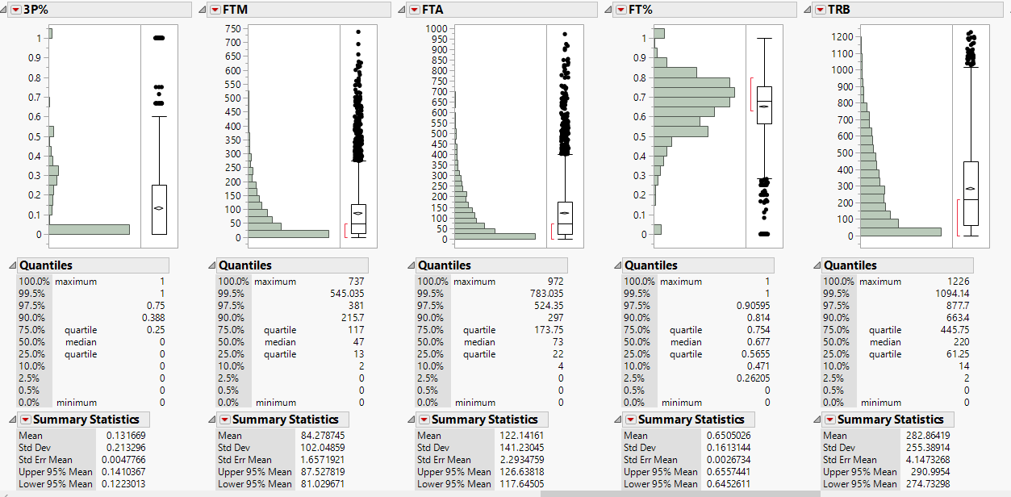
Who is the most average Centre of the league?

Slide 25
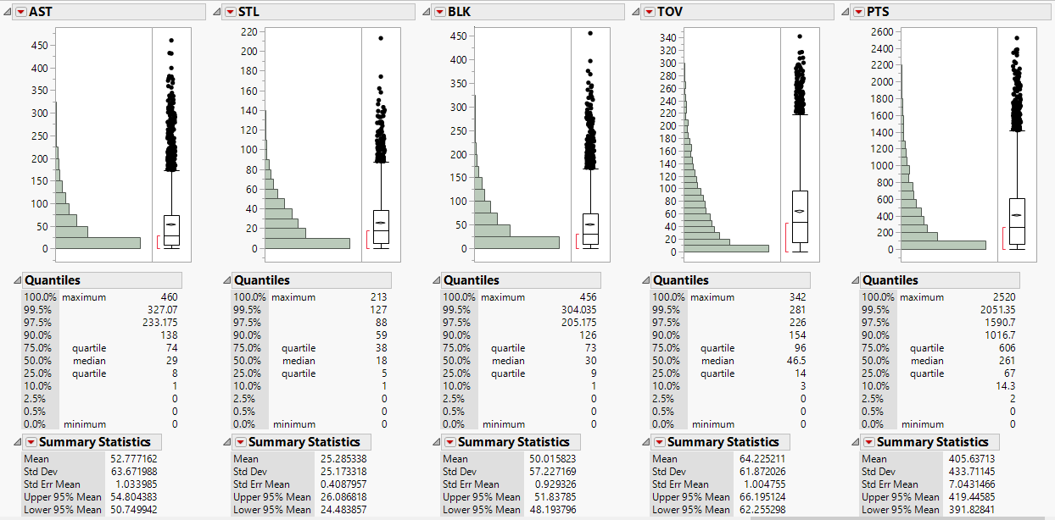
Who is the most average Centre of the league?

Slide 26
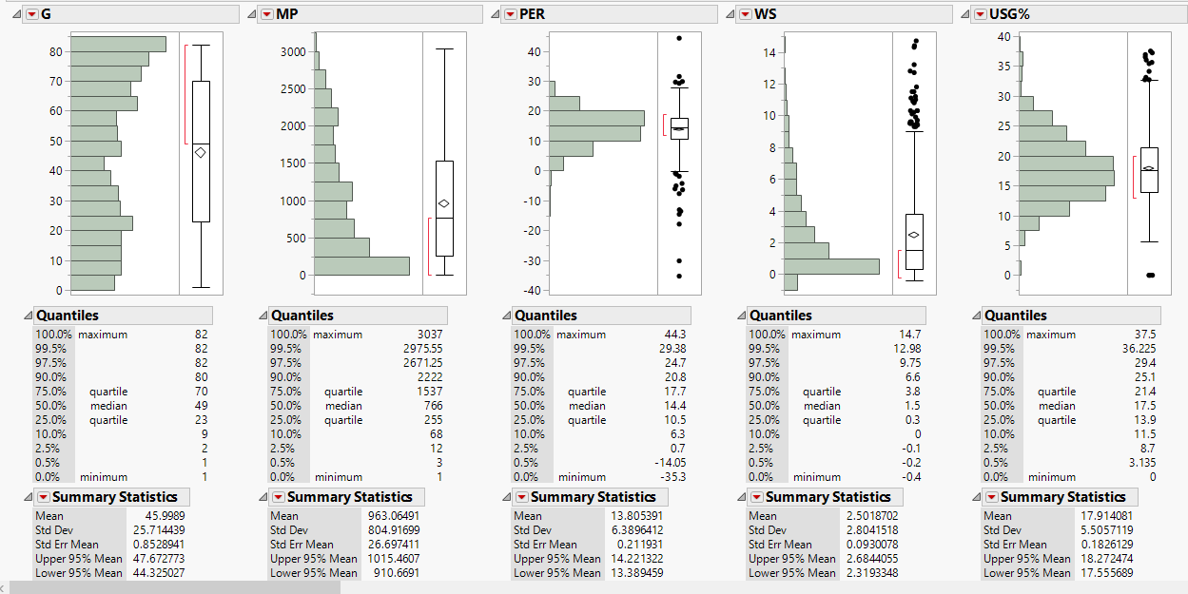
Who is the most average Centre of the league in last 17 years?

Slide 27
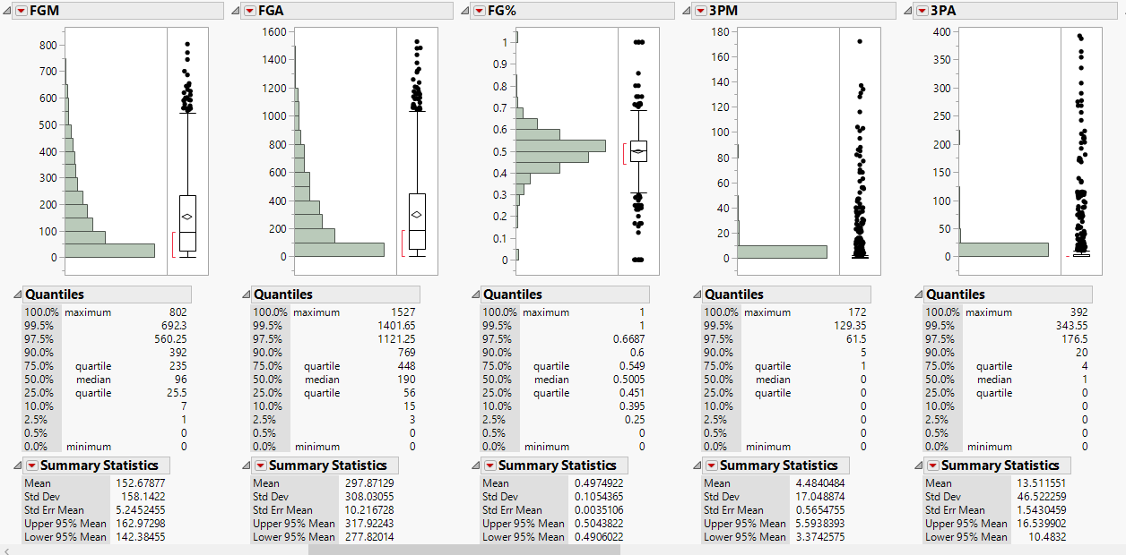
Who is the most average Centre of the league in last 17 years?

Slide 28
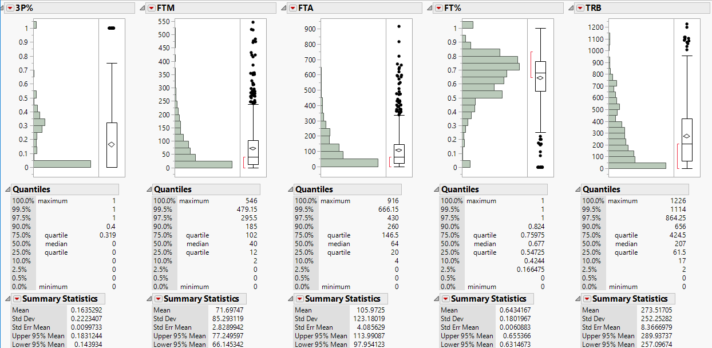
Who is the most average Centre of the league in last 17 years?

Slide 29
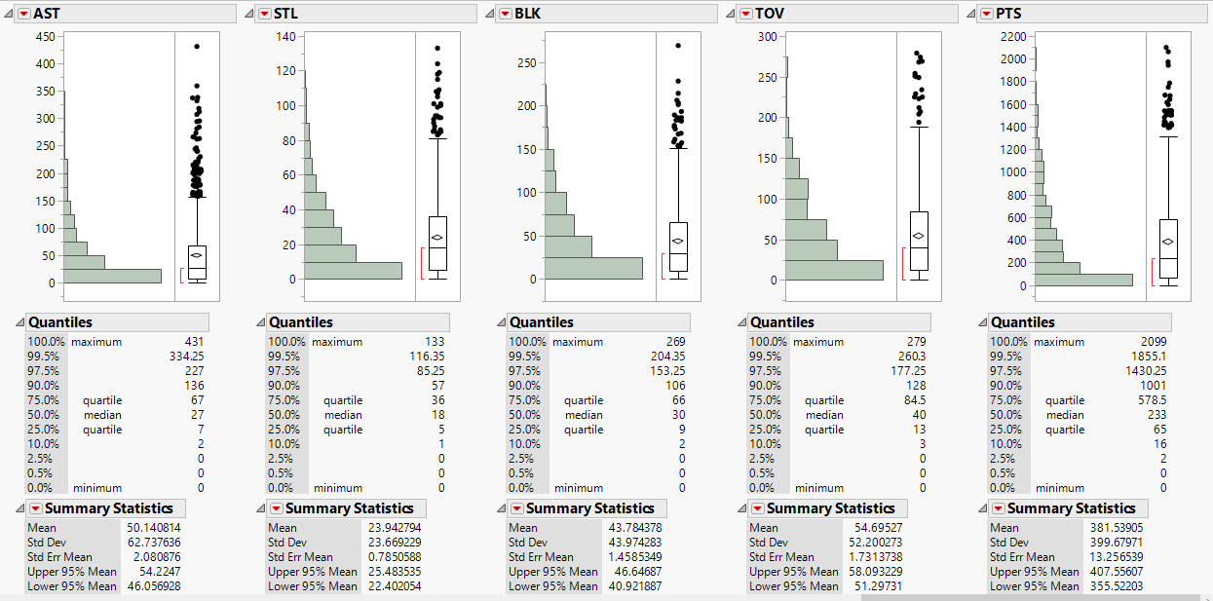
Who is the most average Centre of the league in last 17 years?

Slide 30
Analysis on Centre.
The most surprising thing here is that despite new training sets and equipment the FT% has shown no significance increase in number.
The number of games and minutes played has decreased which in turn has boosted the PER, USG% and WS.
The field goal attempts have decreased which has benefited the field goal percentage.
The modern NBA Centre has adjusted to the trends in today game which is justified by the increase in 3 pointer made and 3 pointer percentage.
Also shocking is the modern Centre has less contribution in defence as rebounds and blocks have increased.

Slide 31
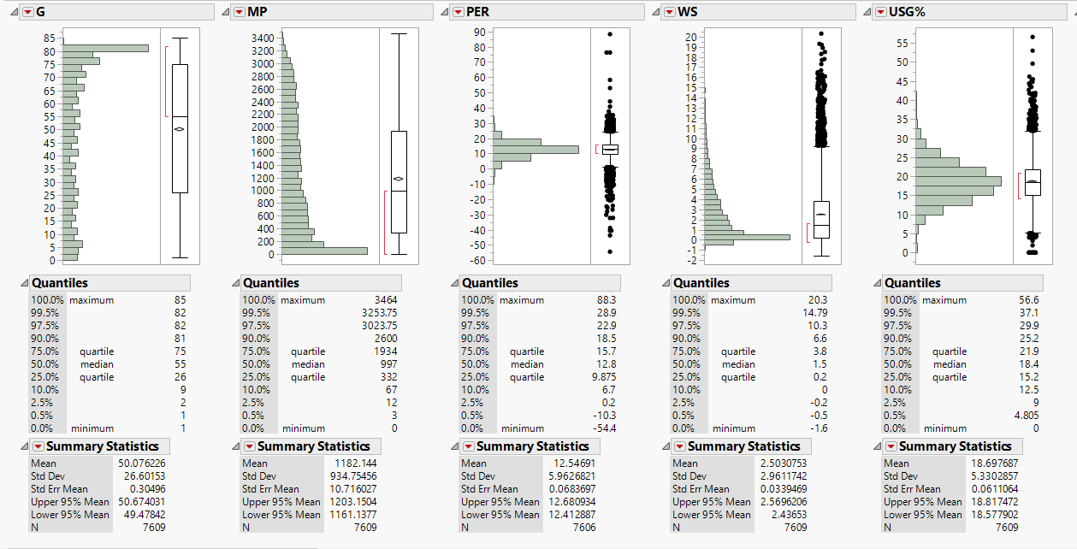
Who is the most average Forward of the league?

Slide 32
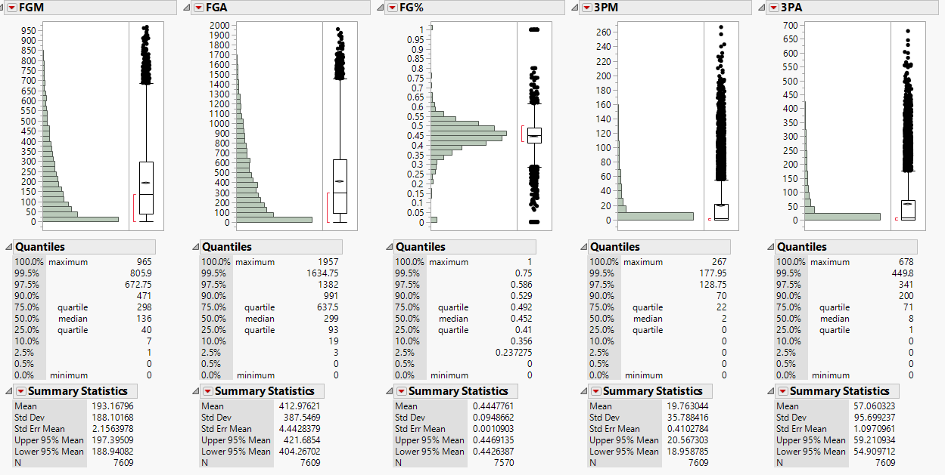
Who is the most average Forward of the league?

Slide 33
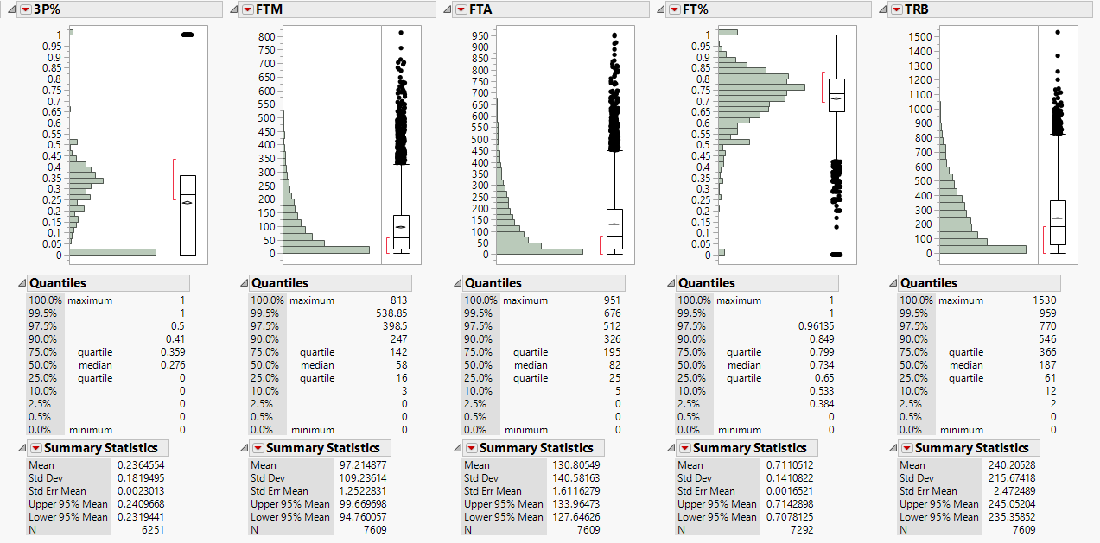
Who is the most average Forward of the league?

Slide 34
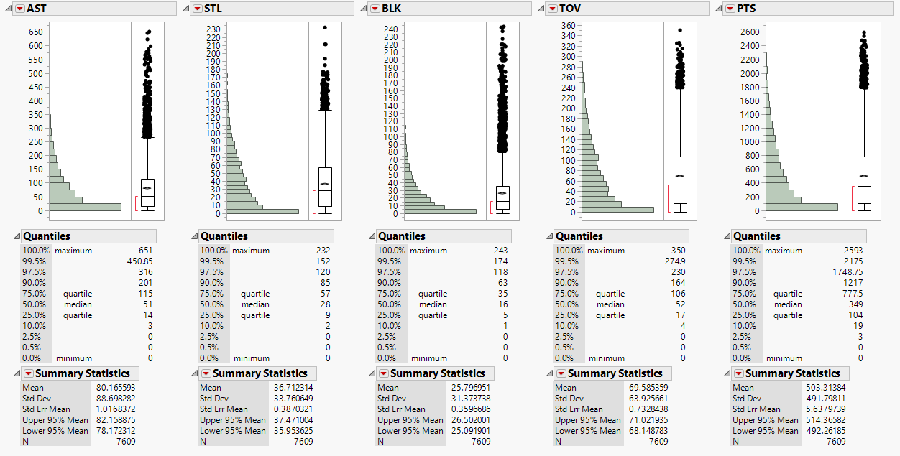
Who is the most average Forward of the league?

Slide 35
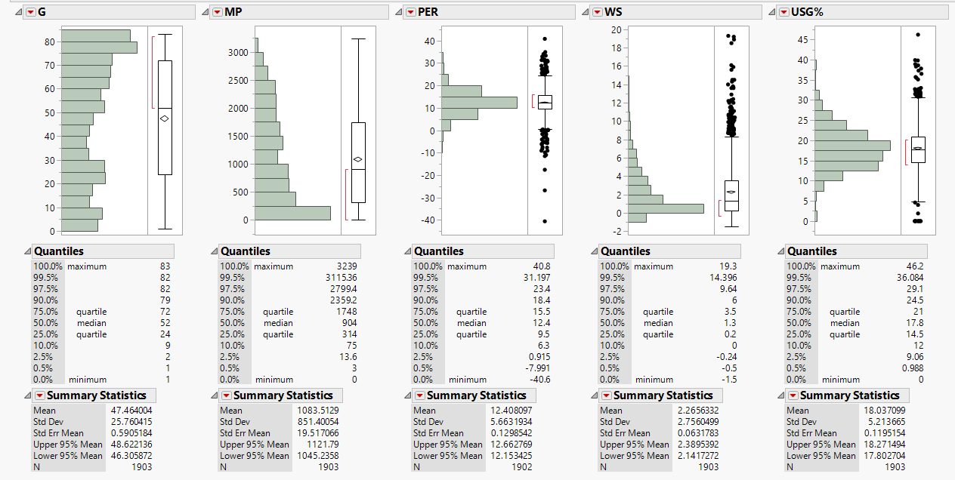
Who is the most average Forward of the league in last 17 years?

Slide 36
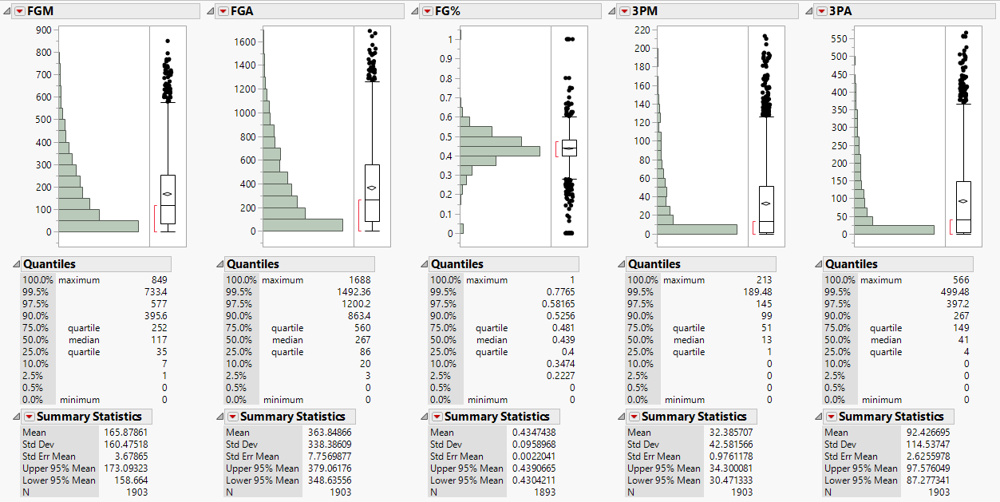
Who is the most average Forward of the league in last 17 years?

Slide 37
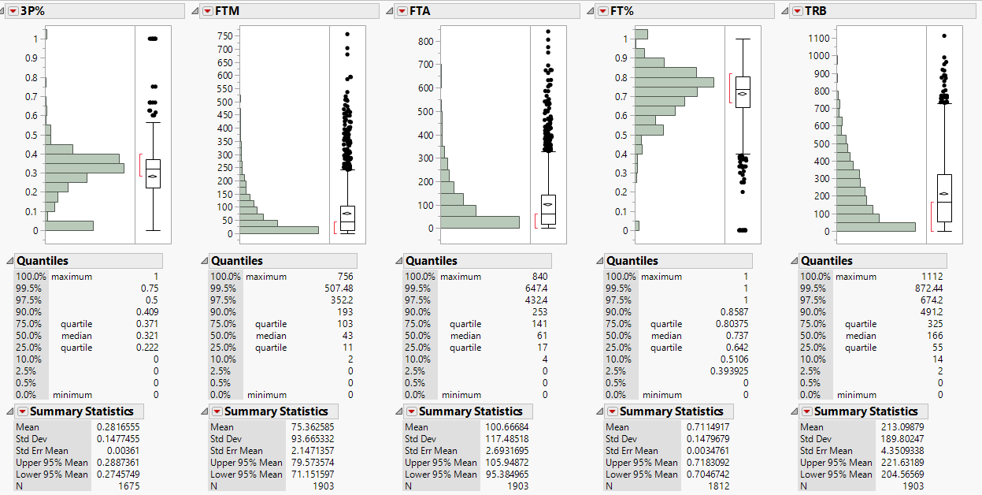
Who is the most average Forward of the league in last 17 years?

Slide 38
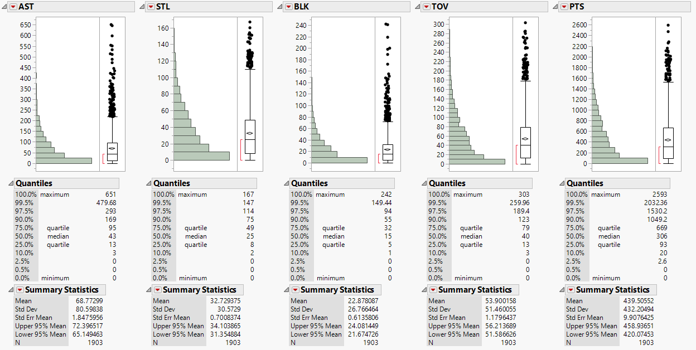
Who is the most average Forward of the league in last 17 years?

Slide 39
Analysis on Forwards.
As the trend goes, the number of games and minutes played has decreased. Also the PER, WS and USG% has decreased which is alarming.
But the modern day forward has added the 3 pointer in his arsenal with an effective increase in 3 point percentage.
The number of points have decreased significantly as the forwards have taken several roles from defence to role players to just offensive players.

Slide 40
As mentioned in previous slide, there is no rigid positions now present in NBA.
The textbook Centre not only does post ups and dunking but also stretches the floor with the added treat of 3 pointer with the likes of Dirk Nowitzki, Channing Frye, Joel Embid.
Also the guards are now classified as layup specialist or a sharp shooter.
But by far the most versatile position is the forward with added rebounding skill, 3 pointer, defensive skills and what not.

Slide 41
Using database analysis tools, I classified NBA players by their feature statistics into natural clusters that best match their skill sets.
The clusters that the we have constructed identify which features are most important to a player and group them in such a way that is easily interpretable and inherently understood by players, coaches, and fans alike.
The new position are:
3 and D Wings
Combo Guards
Defensive Centres
Floor Generals
Offensive Centres
Scoring Wings
Shooting Wings
Versatile Forwards

Slide 42
Notable Player at each Positions
Defensive Centres – DeAndre Jordan, Hassam Whiteside, Robin Lopez
3 and D Wings – Kawhi Leonard, Klay Thompson, Robert Carrington
Scoring Wings – Kevin Durant, Lebron James, James Harden
Versatile Forwards – Dirk Nowitzki, Ryan Anderson, Draymond Green
Floor Generals – Chris Paul, John Wall, Ricky Rubio, Rajon Rondo
Shooting Wings – J.J. Redick, Kyle Korver, Paul Pierce
Combo Guards – Kyrie Irving, Stephen Curry, C.J. McCollum
Offensive Centres – Brook Lopez, Blake Griffin, Kevin Love

Slide 43
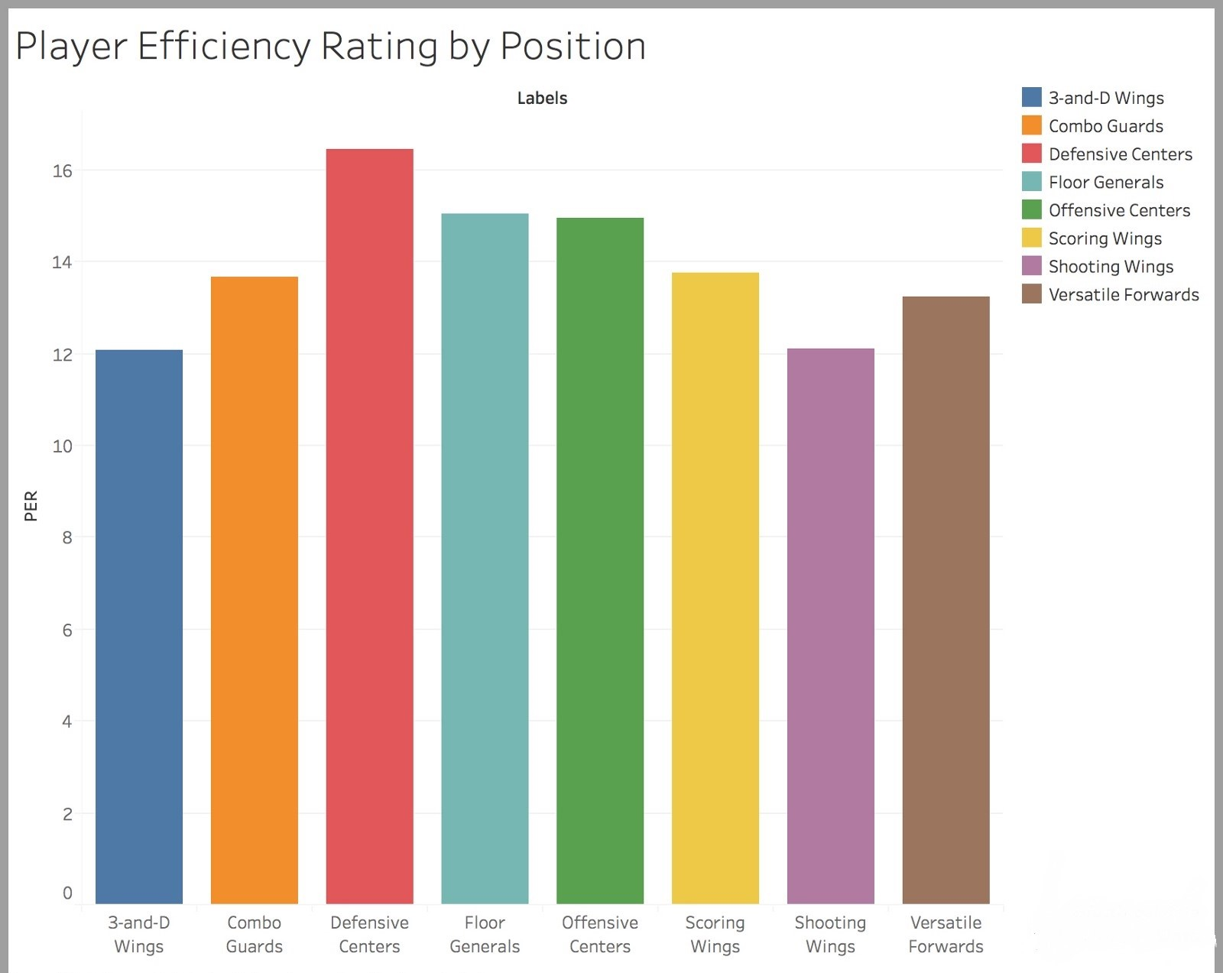
Player Efficiency Rating by Positions

Slide 44
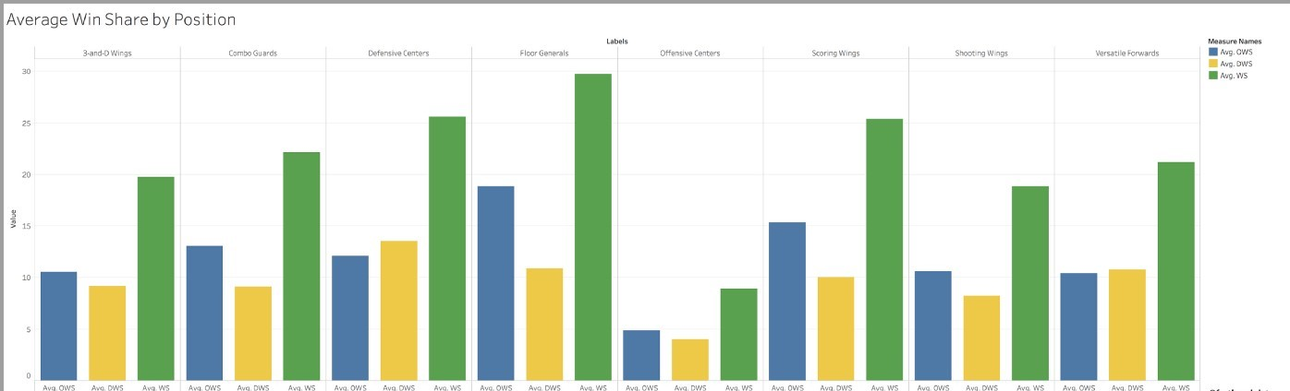
Average Win Shares by Positions

Slide 45
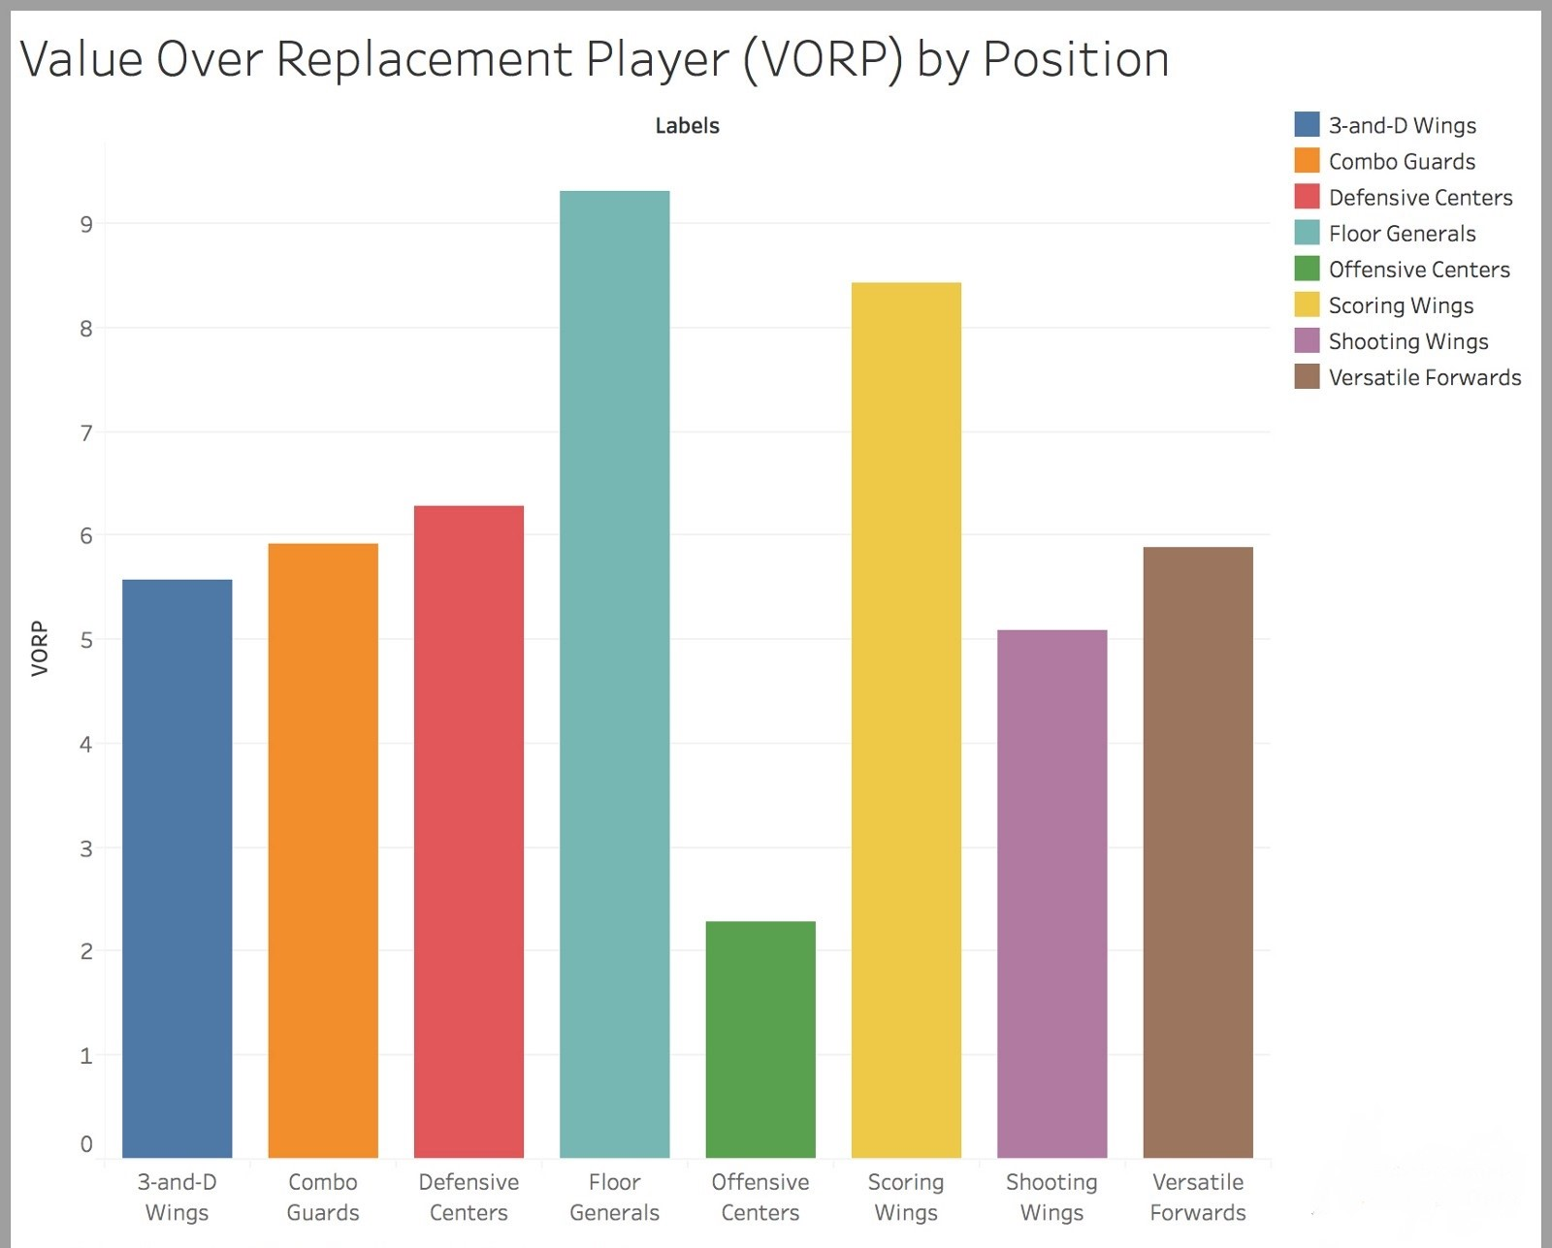
Value Over Replacement Player by Positions

Slide 46
Application of our analysis
Conducting this type of analyses at the collegiate level may also pin point the future stars of the franchises.
With collegiate player data, scouts and front office executives may have a better understanding of whom to draft to succeed and take their team to another level.
This analysis will result in the teams incorporating the results to maximize the skill sets of their players and design offensive and defensive schemes that best put teams in positions to succeed.
Teams indubitably are cognizant of the strengths and weaknesses of their players, but during the season, innately knowing whether an opponent is going to pass, drive, or shoot may make all the difference in a late game possession.

Slide 47
Conclusion
While further investigation into play-by-play data and an analysis of every player in NBA history may also enrich and improve the results, it is evident that the natural clusters in just a three-year timespan immediately define more than five positions in basketball.
In addition, a more in-depth exploration into each cluster may reveal insight into how teams can scout and develop the next BIG THING in NBA.
I argue that there is not an absolute nor correct number of positions in basketball. Trends in the NBA are constantly changing, and this study was intended to provide just a snapshot of the ever changing game.

